Slide 1
Creating menopause supportive workplaces
Webinar
Thursday 05 October, 12:00 – 13:00

Slide 2
Welcome
Claire McCartney
Senior Policy Adviser, CIPD

Slide 3
Today’s speakers
Rachel Suff
Senior Policy Adviser, CIPD
Helen Tomlinson
Head of Talent (UK and Ireland), The Adecco Group
UK Government Menopause Employment Champion
Angie Voidloss
Diversity and Inclusion Manager,
Associated British Foods

Slide 4
#StrongerWithCIPD
Covid-19 resources
NEW Well-being helpline
Employment Law helpline
Communities and branches
People Management
Knowledge and content
Free learning
Careers support
Professional creditability
Financial support
cipd.org/uk/membership/member-benefits/

Slide 5
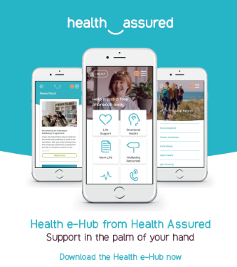
Wellbeing Resources
We’ve partnered with Health Assured to support members mental health and wellbeing
Unlimited free 24/7 confidential telephone helpline, online portal & Health e-Hub app
The resource provides:
Legal information
Debt and financial information
Manager consultancy and support
Information on work and home issues
Factsheets, advice, information and self-help tools
Links to specialist support organisations
A resources area with; programmes, videos, webinars, medical information and mini health checks.
Notes:
In recognition of the increased pressure and personal challenges many of you might currently be facing we’re launched a new Well-being helpline for the UK and Ireland. Calls are FREE and confidential. Phonelines are open 24 hours a day, 7 days a week, 365 days a year.
Work through your problems with a qualified therapist accredited by the British Association for Counselling and Psychotherapy (BACP).
Legal information services - support on a range of issues including personal, financial and legal matters.
Debt and financial information - support for issues such as debt, investments, pensions, managing money, negotiating with creditors.
Manager consultancy and support - at helping people managers to support their teams effectively.
Plus there are online resources and a well-being app you can download.

Slide 6
Rachel Suff
Senior Policy Adviser, CIPD

Slide 7
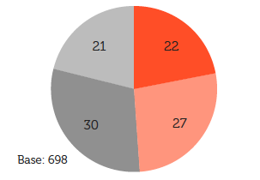
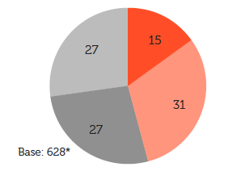
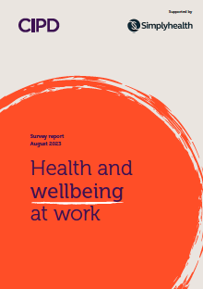
Support for menopause transition at work is on the up!
Around half (49%) of organisations
‘encourage an open and supportive climate where people can talk about menopause transition’
46% of organisations’ wellbeing activity includes provision for menopause transition

Slide 8
Government and employer action means the foundations are there to create a future where every employee with menopause symptoms can receive understanding and support

Slide 9
The gap in menopause provision needs to close completely

Slide 10
Lack of support can have serious consequences for career progression
More than 1 in 4 ((27%) women with menopause symptoms – equating to an estimated 1.2 million in the labour market – think that menopause has had a negative impact on their career progression.
“I have been unable to continue a career which I had developed over a period of 25-plus years due to being unsupported with symptoms of brain fog/extreme fatigue/mood swings/stress and this has led to me having to take part-time low-paid work”

Slide 11
Wider impacts on work and wellbeing
Almost 1 in 4 (23%) have considered leaving work, or have left work, due to a lack of support for their menopause symptoms
Having a disability or long-term health condition can exacerbate the impact of not having support in place
Individuals who feel unsupported by their employer are significantly more likely to report an increased amount of pressure and stress
Over half (53%) have been unable to go into work at some point due to their menopause symptoms
Many felt unable to tell their manager the real reason for their absence

Slide 12
Support and understanding can make a huge difference to how people manage work and menopause symptoms

Slide 13
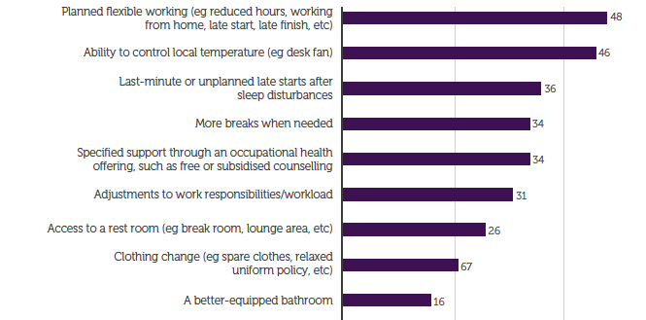
Most valued types of support to manage menopause symptoms

Slide 14
A healthy workplace culture helps people feel supported

Slide 15
Helen Tomlinson
Head of Talent (UK and Ireland), The Adecco Group
UK Government Menopause Employment Champion

Slide 16
Creating menopause supportive workplaces
Angie Voidloss
Diversity and Inclusion Manager, Associated British Foods

Slide 17
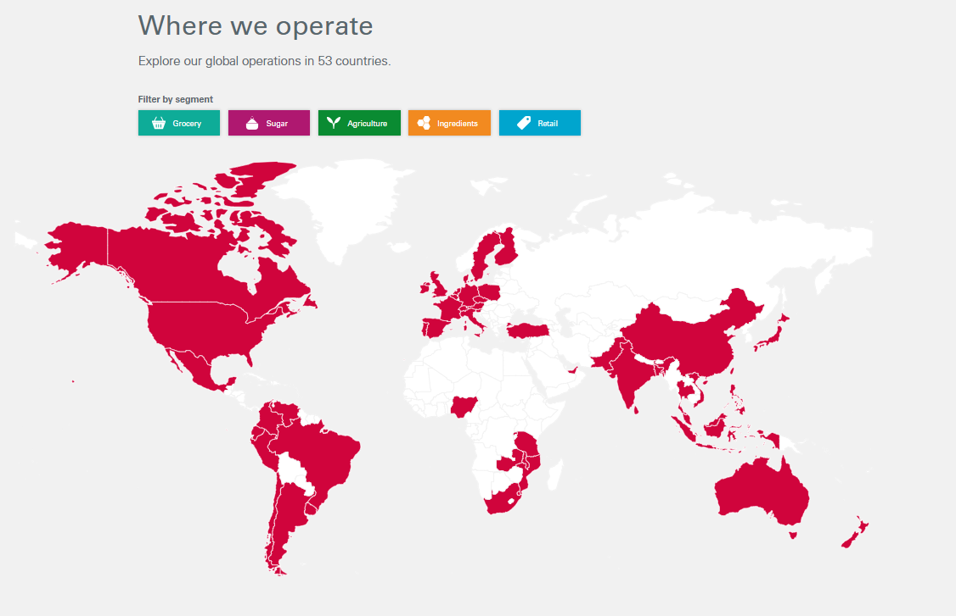
Overview of Associated British Foods
Operating in 53 countries
Our purpose: to provide safe, nutrition and affordable food, and clothing that is great value for money

Slide 18
Overview of Associated British Foods in the UK

Slide 19
The context in the UK for our people differs across our businesses
Various working locations
Hybrid / site based
Field based
Different working environments
Cleanroom laboratories
Community partner events
Numerous working patterns
Rotating shift pattern
Flexible working
Machine operator without allocated digital device
Differing access to digital platforms
Computer – based with company mobile

Slide 20
We have used a mix of approaches to create menopause supportive workplaces
Asked people
Training
Knowledge share
Process/ policies
Wellbeing
Conversations
Media Club
Apparel
Supplies

Slide 21
Our key learnings
Ask people what will help – don’t assume
Make information accessible
Tell people about support multiple times
Focus on the needs of the audience
Create safe spaces for conversation and questions
Engage all colleagues – not just line managers
Align with the business context and culture
Find role models willing to share their stories
Senior sponsorship is key

Slide 22
Questions
Please share any questions you have for our panellists using the Q&A tab.

Slide 23
Wellbeing Resources
We’ve partnered with Health Assured to support members mental health and wellbeing
Unlimited free 24/7 confidential telephone helpline, online portal & Health e-Hub app
The resource provides:
Legal information
Debt and financial information
Manager consultancy and support
Information on work and home issues
Factsheets, advice, information and self-help tools
Links to specialist support organisations
A resources area with; programmes, videos, webinars, medical information and mini health checks.
Notes:
In recognition of the increased pressure and personal challenges many of you might currently be facing we’re launched a new Well-being helpline for the UK and Ireland. Calls are FREE and confidential. Phonelines are open 24 hours a day, 7 days a week, 365 days a year.
Work through your problems with a qualified therapist accredited by the British Association for Counselling and Psychotherapy (BACP).
Legal information services - support on a range of issues including personal, financial and legal matters.
Debt and financial information - support for issues such as debt, investments, pensions, managing money, negotiating with creditors.
Manager consultancy and support - at helping people managers to support their teams effectively.
Plus there are online resources and a well-being app you can download.

