Slide 1
CIPD webinar: Supporting employees through pregnancy or baby loss
13 October 2022

Slide 2
Welcome
Jill Miller, Senior Policy Advisor - Diversity and Inclusion, CIPD

Slide 3
Today’s speakers
David D’Souza
Membership Director, CIPD
Rachel Suff
Senior Policy Advisor – Employee Relations, CIPD
Vicki Robinson
Deputy Director, Miscarriage Association
Rosie Leverton
Head of Corporate Partnerships, Tommy’s
Helen Hicks
Colleague Experience Manager, Co-op

Slide 4
Useful resources:
www.miscarriageassociation.org.uk
www.tommys.org.uk
CIPD report
Line manager resources
Case study – Co-op

Slide 5
#StrongerWithCIPD
Covid-19 resources
NEW Well-being helpline
Employment Law helpline
Communities and branches
People Management
Knowledge and content
Free learning
Careers support
Professional creditability
Financial support
cipd.co.uk/memberbenefits

Slide 6
Wellbeing Resources
We’ve partnered with Health Assured to support members mental health and wellbeing
Unlimited free 24/7 confidential telephone helpline, online portal & Health e-Hub app
The resource provides:
Legal information
Debt and financial information
Manager consultancy and support
Information on work and home issues
Factsheets, advice, information and self-help tools
Links to specialist support organisations
A resources area with; programmes, videos, webinars, medical information and mini health checks.
Notes:
In recognition of the increased pressure and personal challenges many of you might currently be facing we’re launched a new Well-being helpline for the UK and Ireland. Calls are FREE and confidential. Phonelines are open 24 hours a day, 7 days a week, 365 days a year.
Work through your problems with a qualified therapist accredited by the British Association for Counselling and Psychotherapy (BACP).
Legal information services - support on a range of issues including personal, financial and legal matters.
Debt and financial information - support for issues such as debt, investments, pensions, managing money, negotiating with creditors.
Manager consultancy and support - at helping people managers to support their teams effectively.
Plus there are online resources and a well-being app you can download.

Slide 7
Supporting employees through pregnancy or baby loss
Rachel Suff
Senior Policy Advisor – Employee Relations, CIPD

Slide 8
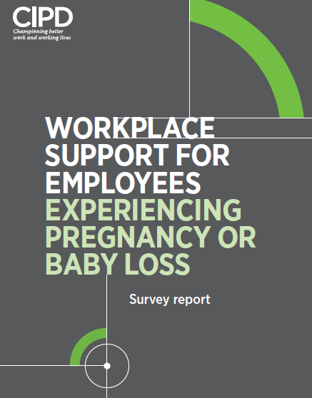
The current climate: key findings
Employers
Just over 1 in 3 have a policy
Just 1 in 4 senior decision-makers say their organisation encourages an open and supportive climate where employees can discuss issues like pregnancy loss
Employees
45% felt supported by their employer but 21% received no support
Almost 1 in 4 have considered leaving their job
Just over half felt able to tell their employer about their experience

Slide 9
A framework of support for employees
Challenge the taboo and raise awareness
An open, inclusive and supportive culture
Leave and absence - compassion and flexibility
Line managers – empathy and practical help

Slide 10
The value of line managers supporting employees
‘Understanding from my manager that it can be a challenging time’ is considered the 2nd most helpful form of support
Where people felt supported by their manager, over half said it had a positive impact on their mental wellbeing, their ability to perform in their job, their commitment to employer, their intention to stay with employer
Almost 3 in 4 employees who had not felt supported would have found line manager support beneficial

Slide 11
The line manager role
Empathetic and sensitive conversations
In the context of a trust-based relationship, where line managers are open and approachable, so that employees feel safe to talk about sensitive issues like health and loss
➔
A gateway for helpful support and adjustments
Manage leave, absence, return to work flexibly

Slide 12
Useful resources:
www.miscarriageassociation.org.uk
www.tommys.org.uk
CIPD report
Line manager resources
Case study – Co-op

Slide 13
Pregnancy loss – facts and feelings
Vicki Robinson
Deputy Director, Miscarriage Association

Slide 14
About the Miscarriage Association
Registered UK charity
Free support and information to anyone affected by miscarriage, ectopic or molar pregnancy
Awareness and education for the public and professionals
Promoting good care, eg, by advising on programmes like the National Bereavement Care Pathway
Resources to support employees, employers, HR and line managers

Slide 15
Miscarriage
An estimated 1 in 4 pregnancies ends in miscarriage
Around 250,000 pregnancy losses each year in the UK
It can be very emotionally and physically distressing
Many women and their partners experience pregnancy loss as a bereavement like any other
It is usually an one-off but many couples experience recurrent miscarriage

Slide 16
Ectopic pregnancy
Around 1 in 80 pregnancies is ectopic
An ectopic pregnancy cannot survive and will need medical or surgical management. It can be life-threatening
Molar pregnancy
1 in 600 pregnancies are molar which is due to abnormal conception and development
Molar pregnancies cannot survive and need specialist follow-up

Slide 17
Embryo transfer loss
Fertility treatment does not result in pregnancy
Abortion/termination
Surgical or medical intervention
Maternal health/foetal anomaly
Stillbirth or neonatal death
1 in 250 babies are stillborn
1 in 360 babies die before 28 days old

Slide 18
Physical impact of pregnancy loss
Spontaneous or expectant, medical or surgical management
Pain and bleeding, labour-like process/contractions
Collapse (ectopic pregnancy), severe loss of blood
Ongoing medical appointments/procedures
Trouble sleeping – tiredness/exhaustion
Weakness
Hormonal changes/mood swings

Slide 19
Feelings after pregnancy loss
Shock Distress Powerlessness Grief and loss
Emptiness Anger Seeking reasons Guilt/blame
Failure Jealousy Isolation Anxiety
Needing to be strong Relationship problems

Slide 20
Miscarriage and mental health
One month after pregnancy loss …
Almost a third of women had symptoms of PTSD
1 in 4 had moderate to severe anxiety
1 in 10 had moderate to severe depression
Nine months after pregnancy loss …
1in 5 women were experiencing symptoms of PTSD, equating to around 45,000 a year
17% had moderate to severe anxiety, 6% had moderate to severe depression

Slide 21
Partners, too
One month after pregnancy loss …
1 in 14 had symptoms of PTSD
Three months after pregnancy loss …
1 in 12 had symptoms of PTSD
Nine months after pregnancy loss …
1 in 25 were still showing symptoms of PTSD
*Studies by Bourne, Farren et al at Imperial College, London, 2020.

Slide 22
More information
Free workplace resources
Information for employers, employees, managers and HR
Policy template and guidance
Training and consultancy
Pregnancy Loss Pledge
miscarriageassociation.org.uk

Slide 23
Top 5 things you can do to support your employees through pregnancy and baby loss
Rosie Leverton
Head of Corporate Partnerships at Tommy’s

Slide 24
We exist to save babies’ lives
At Tommy’s, we refuse to accept that 1 in 4 pregnancies end in loss or
premature birth.
We’re dedicated to finding causes and treatments to save babies’ lives as well as providing trusted expert information and support for everyone, no matter their experience.

Slide 25
69% of parents felt their manager wanted to support them,
but only 33% said they actually knew how to.
54% of people who lost a baby said nobody at work acknowledged it or asked how they were
20% of miscarriages leave symptoms of PTSD
for both parents, over 9 months later.
[1] Tommy’s supporter survey (sample size 1,063), June 2021 [2]“Differences in post-traumatic stress, anxiety and depression following miscarriage or ectopic pregnancy between women and their partners”, Tommy’s
National Centre for Miscarriage Research, October 2020

Slide 26
‘At least you weren’t too far along’
‘You can always try for
‘Everything happens ^{another one’} for a reason’
‘At least you know you can get pregnant’

Slide 27
1. Train your managers
‘Yuen went back to work too soon and had a bit of a meltdown. Despite trying, her manager didn’t seem to know how to deal with the situation. I was really lucky, my manager took me aside and explained he’d been through it with his wife and told me to take whatever time I needed.’
Matt and his wife Yuen have lost 2 babies
Remember, only 1 in 3 managers know how to support.

Slide 28
2. Have an explicit loss policy
Seek expert advice on language and including different types of loss.
Think about where your policy is found.
What’s your backup plan if the manager has also experienced loss?
Consider family members and partners. We recommend that your policy applies to both parents regardless of gender.
A set amount of leave can be a guide, but make no assumptions. Equip your managers to have supportive conversations and allow for flexibility.

Slide 29
3. Be flexible
Grief is different for everyone.
Create a clear return to work approach with options for phased returns, home working, and regular reviews with your employee.
Be flexible around requests for leave around difficult anniversaries, such as their baby’s due date.
Know that your employee may need more time off after their initial return to work for more treatments and tests, or in future pregnancies. Remember partners.

Slide 30
Loss affects partners too
74% 73%
60%
feel support for dads and partners during and after pregnancy loss is little to non- existent.
feel that dads and partners face pressure to ‘be the strong one’
said that not wanting to burden the mother would mean they wouldn’t know who they could lean on.
*Figures from a study of 1000 people from Tommy’s National Centre for Miscarriage Research

Slide 31
4. Talk about their loss
Don’t:
Try to avoid your colleague out of fear of saying the wrong thing.
Try and find a bright side or “solutions”.
Ask them to make lots of decisions, even if well-intentioned.
You see the fear in people’s eyes the first time they have to talk to you. You know they’re so afraid. ‘Will I say something wrong?’ ‘Will I upset her?’ ‘Will I remind her that her baby has died?’ The truth is I never forget so they don’t need to worry about these things.
Anne-Marie’s baby boy Ruairi was stillborn

Slide 32
4. Talk about their loss
Do:
Think of ways to avoid any emotional distress, such as advanced warning about baby related announcements. Ask if or how they would like news of their loss to be shared.
Use or ask their baby’s name.
Be aware of significant dates.
When I went back to work I wanted everyone to know that our son had died and I also wanted to introduce him. I’m still proud that he’s my son so I sent a note to tell people that he had born and he had died, his weight, that his name was Ruairi, and who
he looked like.
Anne-Marie

Slide 33
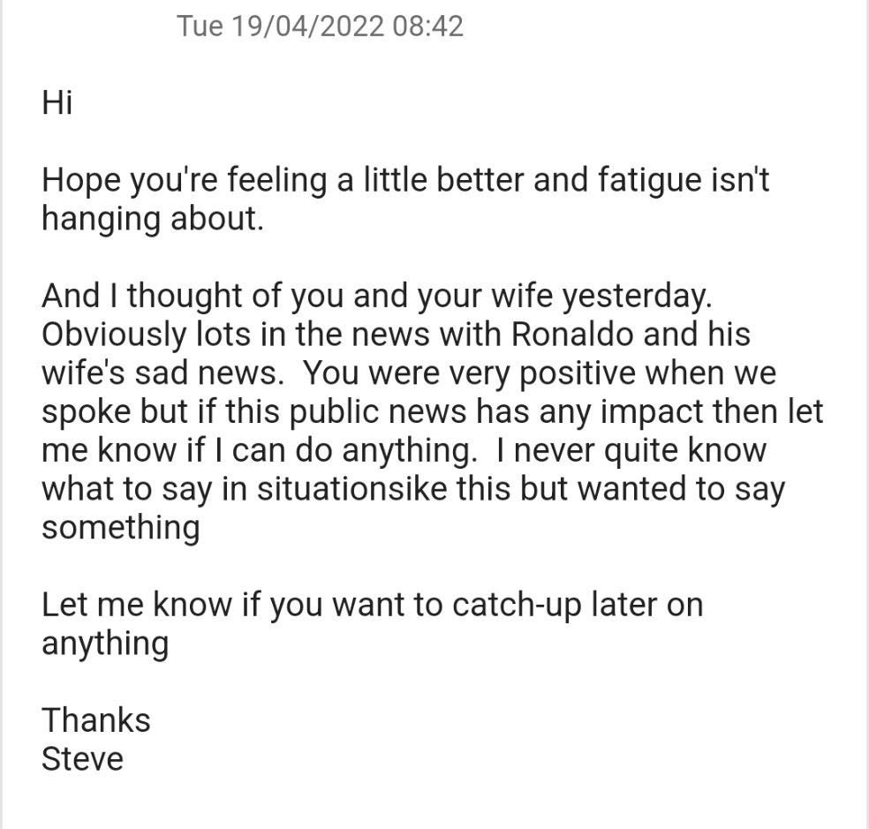
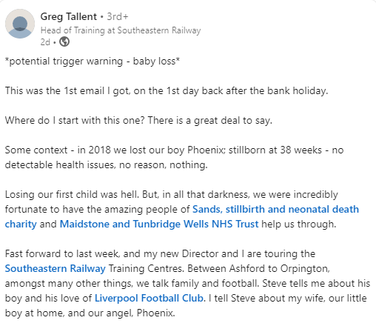

Slide 34
‘I remember after the second loss, going to lunch with a colleague at work, who asked me, “How are you doing?” It was the first time anyone had asked me that and I really appreciated it ’
Matt

Slide 35
5. Break the silence
Acknowledge key dates that may be difficult
Mother’s Day/Father’s Day
Baby Loss Awareness Week (October 9-15th)
World Prematurity Day (17th November)
Hold support sessions on how to support colleagues and listening sessions
Consider employee support groups – BUT be careful of how you use these (e.g. don’t rely on “Women” or “Family” networks)

Slide 36
Top 5 tips:
Train your managers
Have an explicit policy
Be flexible
Talk about their loss
Break the silence

Slide 37
Support available to you
tommys.org/work: support and information for all types of pregnancy and baby loss. We also offer workplace training and support.
miscarriageassociation.org.uk: offers support and information to people affected by miscarriage.
sands.org.uk: a stillbirth and neonatal death charity providing bereavement support services.
petalscharity.org: specialist counselling for parents following baby loss.
abortiontalk.com: a charity aiming to provide opportunities for anyone emotionally affected by termination, including termination for medical reasons, to talk about their experiences in a non-judgmental and supportive environment.
arc-uk.org: helps parents through antenatal screening and its consequences.

Slide 38
For more support:
rleverton@tommys.org

Slide 39
Case study: Supporting employees through pregnancy or baby loss
Helen Hicks
Colleague Experience Manager, Co-Op

Slide 40
Questions
Please submit your questions for:
Rachel Suff, Senior Policy Advisor – employee relations, CIPD
Vicki Robinson, Deputy Director, Miscarriage Association
Rosie Leverton, Head of Corporate Partnerships, Tommy’s
Helen Hicks, Colleague Experience Manager, Co-op
Please use the Q&A function to submit your questions

Slide 41
#StrongerWithCIPD
Covid-19 resources
NEW Well-being helpline
Employment Law helpline
Communities and branches
People Management
Knowledge and content
Free learning
Careers support
Professional creditability
Financial support
cipd.co.uk/memberbenefits

Slide 42
Wellbeing Resources
We’ve partnered with Health Assured to support members mental health and wellbeing
Unlimited free 24/7 confidential telephone helpline, online portal & Health e-Hub app
The resource provides:
Legal information
Debt and financial information
Manager consultancy and support
Information on work and home issues
Factsheets, advice, information and self-help tools
Links to specialist support organisations
A resources area with; programmes, videos, webinars, medical information and mini health checks.
Notes:
In recognition of the increased pressure and personal challenges many of you might currently be facing we’re launched a new Well-being helpline for the UK and Ireland. Calls are FREE and confidential. Phonelines are open 24 hours a day, 7 days a week, 365 days a year.
Work through your problems with a qualified therapist accredited by the British Association for Counselling and Psychotherapy (BACP).
Legal information services - support on a range of issues including personal, financial and legal matters.
Debt and financial information - support for issues such as debt, investments, pensions, managing money, negotiating with creditors.
Manager consultancy and support - at helping people managers to support their teams effectively.
Plus there are online resources and a well-being app you can download.

